Slide 1

BLUETOOTH
LED MATTRIX
CONTROLLER
Group 03

Slide 2



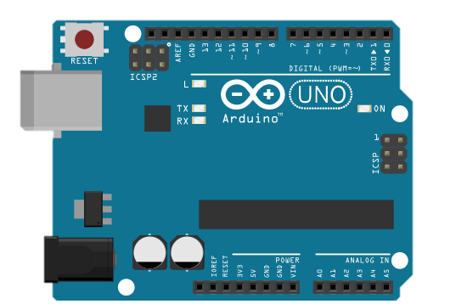

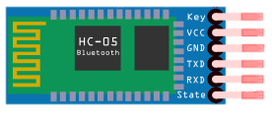

COMPONENT REQUIRED
HOOKUP-WIRE
RESISTOR
10K OHM
TEMPERATURE SENSOR
PHOTORESISTOR
LM35
MODULE LED MATRIX 8X32
BLUETOOTH MODULE
MAX 7219
HC-05

Slide 3
SOFWARE REQUIREMENT
01
02
03
JUPITER
NEPTUNE
MARS
It’s the biggest planet of them all
It’s the farthest planet from the Sun
Despite being red, it’s a cold place
04
05
06
MERCURY
EARTH
SATURN
It’s the closest planet to the Sun
It’s the third planet from the Sun
It’s a gas giant and has several rings

Slide 4
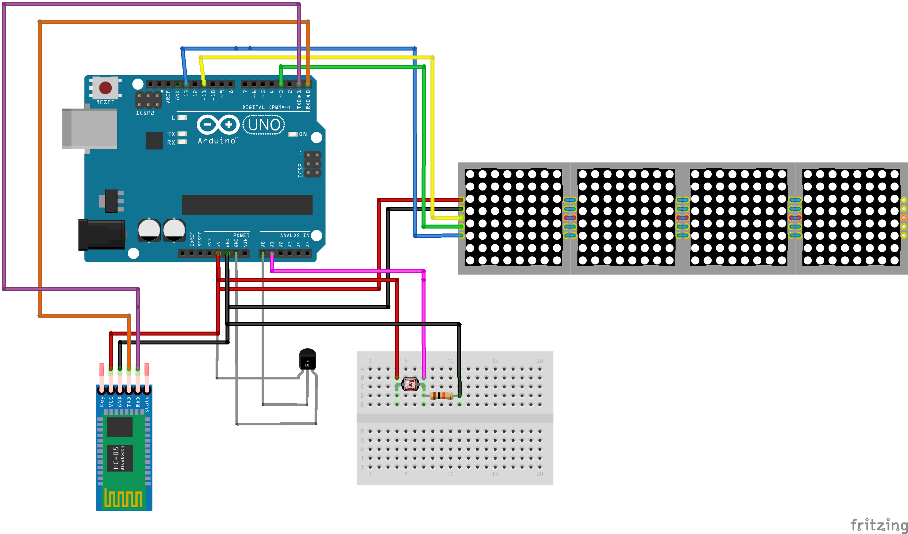
CIRCUIT IMAGE

Slide 5
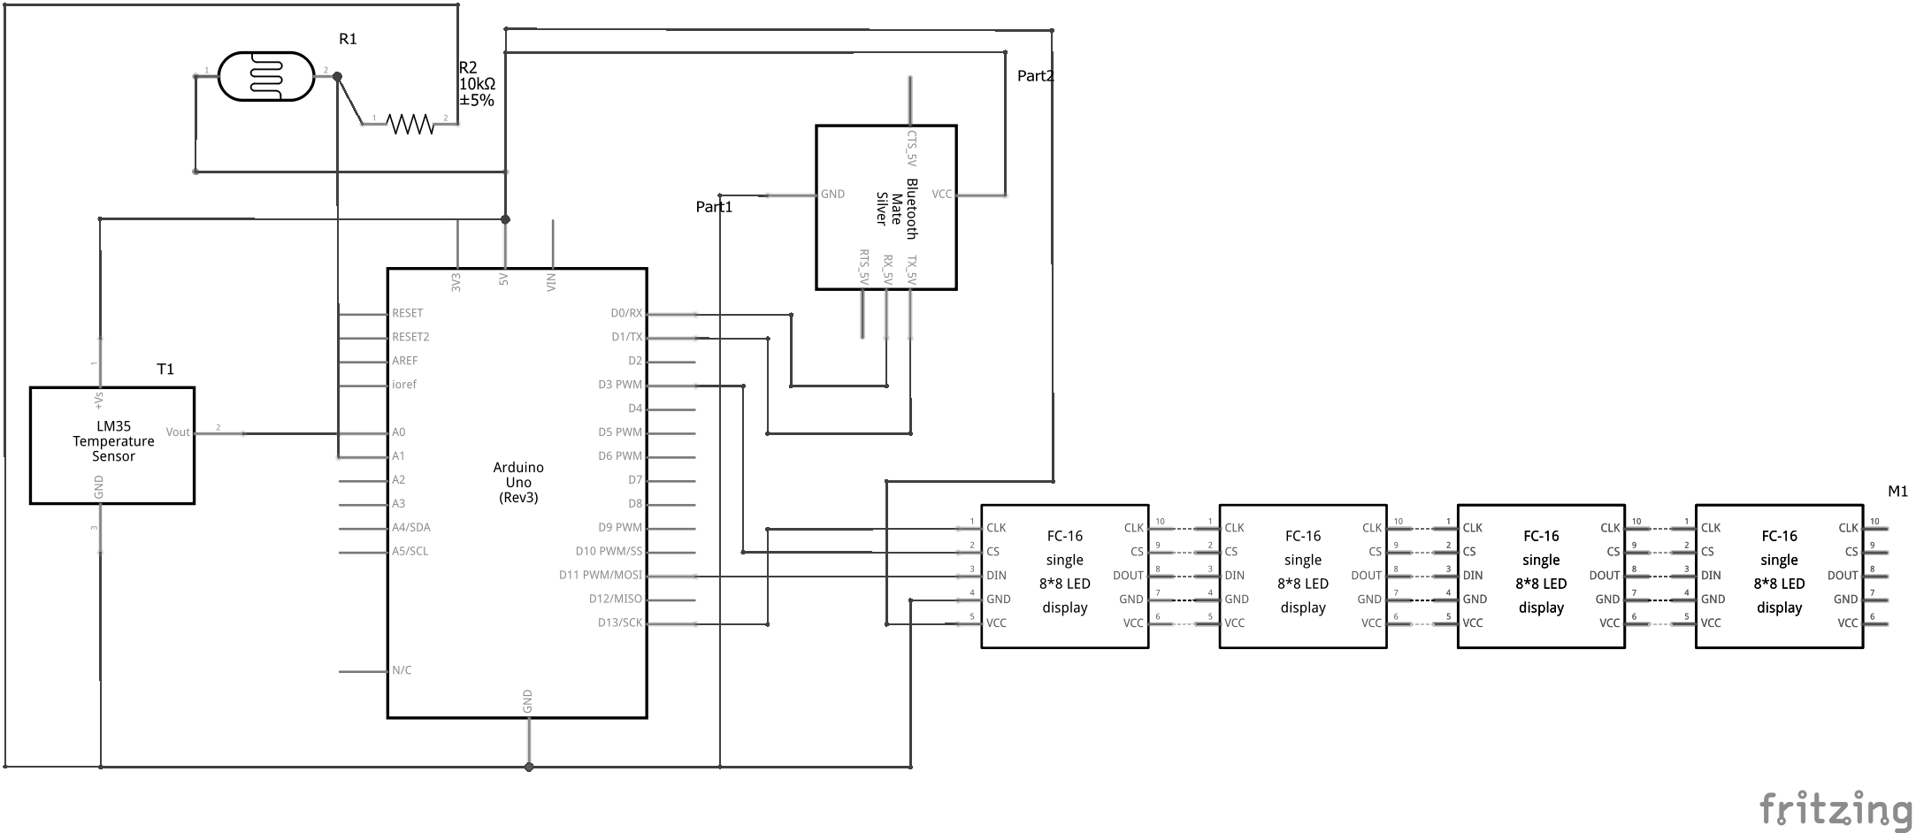
SHCEMA IMAGE

Slide 6
HOW TO USE
STEP 1
STEP 2
DOWNLOAD ARDUTOOTH
CONNECT TO HC-05 MODULE
STEP 3
USE COMMAND TO RUN PROJECT

Slide 7
COMMAND LINE USE
01
02
JUPITER
NEPTUNE
It’s the fifth planet from the Sun and the biggest
It’s the eighth and farthest planet from the Sun
03
VENUS
Venus is the second planet from the Sun

Slide 8
CHALKBOARD BACKGROUND INFOGRAPHICS
JUPITER
01
It’s the biggest planet of them all
MERCURY
02
05
It’s the closest planet to the Sun
NEPTUNE
The farthest planet from the Sun
EARTH
It’s the third planet from the Sun
MARS
03
04
Despite being red, it’s a cold place

Slide 9
CHALKBOARD BACKGROUND INFOGRAPHICS
MERCURY
It’s the closest planet to the Sun
JUPITER
It’s the biggest planet of them all
SUN
SATURN
EARTH
It’s a gas giant and has several rings
It’s the third planet from the Sun
MARS
Despite being red, it’s a cold place

Slide 10
CHALKBOARD BACKGROUND INFOGRAPHICS
01
JUPITER
It’s the fifth planet from the Sun
02
It’s the farthest planet from the Sun
NEPTUNE
03
It’s the second planet from the Sun
VENUS
04
MARS
It’s the fourth planet from the Sun

Slide 11
CHALKBOARD BACKGROUND INFOGRAPHICS
20%
It’s the fifth planet from the Sun and the largest in the Solar System
15%
It’s a gas giant with an average radius of about nine times that on Earth
65%
Mars is the fourth planet from the Sun and it’s actually a cold place

Slide 12
CHALKBOARD BACKGROUND INFOGRAPHICS
VENUS
MERCURY
Venus is the second planet from the Sun
Mercury is the smallest planet of them all
JUPITER
NEPTUNE
It’s the fifth planet from the Sun and the largest
It’s the eighth and farthest planet from the Sun

Slide 13
CHALKBOARD BACKGROUND INFOGRAPHICS
MARS
It’s the fourth planet from the Sun and it’s a cold place
JUPITER
It’s the fifth planet from the Sun and the largest
MERCURY
NEPTUNE
Mercury is the smallest planet of them all
It’s the eighth and farthest planet from the Sun

Slide 14
CHALKBOARD BACKGROUND INFOGRAPHICS
JUPITER
MARS
It’s the biggest planet of them all
It’s the fourth planet from the Sun
NEPTUNE
MERCURY
EARTH
It’s the farthest planet from the Sun
It’s the closest planet to the Sun
It’s the third planet
from the Sun

Slide 15
CHALKBOARD BACKGROUND INFOGRAPHICS
JUPITER
SATURN
01
04
It’s the fifth planet from the Sun and the largest
It’s a gas giant with a radius of nine times that on Earth
02
03
MARS
VENUS
It’s the fourth planet from the Sun and it’s a cold place
Venus is the second planet from the Sun

Slide 16
CHALKBOARD BACKGROUND INFOGRAPHICS
JUPITER
MARS
SATURN
It’s the fifth planet from the Sun and the largest
It’s the fourth planet from the Sun. It’s cold
It’s a gas giant with a radius of nine times that on Earth
NEPTUNE
VENUS
It’s the eighth and farthest-known solar planet
Venus is the second planet from the Sun

Slide 17
CHALKBOARD BACKGROUND INFOGRAPHICS
JUPITER
MERCURY
It’s the biggest planet of them all
It’s the closest planet to the Sun
NEPTUNE
MARS
It’s the farthest planet from the Sun
It’s the fourth planet from the Sun

Slide 18
CHALKBOARD BACKGROUND INFOGRAPHICS
JUPITER
It’s the fifth planet from the Sun and the largest
MARS
It’s the fourth planet from the Sun and it’s a cold place
SATURN
It’s a gas giant with a radius of nine times that on Earth
VENUS
Venus is the second planet from the Sun

Slide 19
CHALKBOARD BACKGROUND INFOGRAPHICS
JUPITER
MERCURY
It’s the biggest planet of them all
It’s the closest planet to the Sun
NEPTUNE
EARTH
The farthest planet from the Sun
It’s the third planet from the Sun
MARS
SATURN
Despite being red, it’s a cold place
It’s a gas giant and has several rings

Slide 20
CHALKBOARD BACKGROUND INFOGRAPHICS
NEPTUNE
MERCURY
The farthest planet from the Sun
It’s the closest planet to the Sun
JUPITER
EARTH
It’s the biggest planet of them all
It’s the third planet
from the Sun

Slide 21
CHALKBOARD BACKGROUND INFOGRAPHICS
JUPITER
SATURN
It’s the fifth planet from the Sun and the largest in the Solar System
It’s a gas giant with an average radius of nine times that on Earth
MARS
VENUS
Mars is the fourth planet from the Sun and it’s actually a cold place
Venus is the second planet from the Sun. It’s terribly hot

Slide 22
CHALKBOARD BACKGROUND INFOGRAPHICS
01
02
03
04
JUPITER
MARS
SATURN
VENUS
It’s the fifth planet from the Sun and the largest in the Solar System
Mars is the fourth planet from the Sun and it’s actually cold
It’s a gas giant with an average radius of nine times that on Earth
Venus is the second planet from the Sun. It is terribly hot

Slide 23
CHALKBOARD BACKGROUND INFOGRAPHICS
JUPITER
NEPTUNE
MARS
VENUS
SATURN
It’s the fifth planet from the Sun and the largest
It’s the eighth and farthest-known solar planet
It’s the fourth planet from the Sun and it’s cold
Venus is the second planet from the Sun
Saturn is a gas giant and has several rings

Slide 24
CHALKBOARD BACKGROUND INFOGRAPHICS
01
02
03
04
JUPITER
MARS
SATURN
VENUS
It’s the fifth planet from the Sun and also the largest
Mars is the fourth planet from the Sun and it’s cold
It’s a gas giant with a radius of nine times that on Earth
Venus is the second planet from the Sun. It’s terribly hot

Slide 25
CHALKBOARD BACKGROUND INFOGRAPHICS
JUPITER
MARS
NEPTUNE
SATURN
It’s the fifth planet from the Sun and the largest
Mars is the fourth planet from the Sun and it’s cold
It’s the eighth and farthest-known solar planet
Saturn is a gas giant and has several rings

Slide 26
CHALKBOARD BACKGROUND INFOGRAPHICS
JUPITER
It’s the fifth planet from the Sun and the largest
MARS
SATURN
VENUS
Mars is the fourth planet from the Sun
It’s a gas giant and has several rings
Venus is the second planet from the Sun

Slide 27
CHALKBOARD BACKGROUND INFOGRAPHICS
JUPITER
It’s the biggest planet of them all
MERCURY
It’s the closest planet to the Sun
NEPTUNE
The farthest planet from the Sun
EARTH
It’s the third planet from the Sun
MARS
Despite being red, it’s a cold place

Slide 28
CHALKBOARD BACKGROUND INFOGRAPHICS
01
JUPITER
MERCURY
02
06
It’s the biggest planet of them all
It’s the closest planet to the Sun
NEPTUNE
EARTH
The farthest planet from the Sun
It’s the third planet from the Sun
03
05
04
MARS
SATURN
Despite being red, it’s a cold place
It’s a gas giant and has several rings

Slide 29
CHALKBOARD BACKGROUND INFOGRAPHICS
JUPITER
SATURN
01
04
It’s the fifth planet from the Sun and also the largest
It’s a gas giant with a radius of nine times that on Earth
MARS
VENUS
02
03
It’s the fourth planet from the Sun and it’s a cold place
Venus is the second planet from the Sun. It’s terribly hot

Slide 30
CHALKBOARD BACKGROUND INFOGRAPHICS
JUPITER
NEPTUNE
MARS
MERCURY
It’s the biggest planet of them all
The farthest known planet
Despite being red, it’s a cold place
It’s the closest planet to the Sun
01
02
03
04

Slide 31
CHALKBOARD BACKGROUND INFOGRAPHICS
JUPITER
SATURN
It’s the fifth planet from the Sun and also the largest
It’s a gas giant with a radius of nine times that on Earth
01
04
02
03
MARS
VENUS
It’s the fourth planet from the Sun and it’s a cold place
Venus is the second planet from the Sun. It’s terribly hot

Slide 32
CHALKBOARD BACKGROUND INFOGRAPHICS
01
JUPITER
SATURN
It’s the fifth planet from the Sun and also the largest
It’s a gas giant with a radius of nine times that on Earth
02
04
MARS
VENUS
It’s the fourth planet from the Sun and it’s a cold place
Venus is the second planet from the Sun. It’s terribly hot
03

Slide 33
CHALKBOARD BACKGROUND INFOGRAPHICS
04
JUPITER
It’s the biggest planet of them all
FINISH
02
03
NEPTUNE
The farthest known planet
Despite being red, it’s a cold place
MARS
01
START
It’s the closest planet to the Sun
VENUS

Slide 34
Instructions for use (free users)
In order to use this template, you must credit Slidesgo by keeping the Thanks slide.
You are allowed to:
Modify this template.
Use it for both personal and commercial purposes.
You are not allowed to:
Sublicense, sell or rent any of Slidesgo Content (or a modified version of Slidesgo Content).
Distribute this Slidesgo Template (or a modified version of this Slidesgo Template) or include it in a database or in any other product or service that offers downloadable images, icons or presentations that may be subject to distribution or resale.
Use any of the elements that are part of this Slidesgo Template in an isolated and separated way from this Template.
Delete the “Thanks” or “Credits” slide.
Register any of the elements that are part of this template as a trademark or logo, or register it as a work in an intellectual property registry or similar.
For more information about editing slides, please read our FAQs or visit Slidesgo School:
https://slidesgo.com/faqs and https://slidesgo.com/slidesgo-school

Slide 35
Instructions for use (premium users)
In order to use this template, you must be a Premium user on Slidesgo.
You are allowed to:
Modify this template.
Use it for both personal and commercial purposes.
Hide or delete the “Thanks” slide and the mention to Slidesgo in the credits.
Share this template in an editable format with people who are not part of your team.
You are not allowed to:
Sublicense, sell or rent this Slidesgo Template (or a modified version of this Slidesgo Template).
Distribute this Slidesgo Template (or a modified version of this Slidesgo Template) or include it in a database or in any other product or service that offers downloadable images, icons or presentations that may be subject to distribution or resale.
Use any of the elements that are part of this Slidesgo Template in an isolated and separated way from this Template.
Register any of the elements that are part of this template as a trademark or logo, or register it as a work in an intellectual property registry or similar.
For more information about editing slides, please read our FAQs or visit Slidesgo School:
https://slidesgo.com/faqs and https://slidesgo.com/slidesgo-school

Slide 36
Infographics
You can add and edit some infographics to your presentation to present your data in a visual way.
Choose your favourite infographic and insert it in your presentation using Ctrl C + Ctrl V or Cmd C + Cmd V in Mac.
Select one of the parts and ungroup it by right-clicking and choosing “Ungroup”.
Change the color by clicking on the paint bucket.
Then resize the element by clicking and dragging one of the square-shaped points of its bounding box (the cursor should look like a double-headed arrow). Remember to hold Shift while dragging to keep the proportions.
Group the elements again by selecting them, right-clicking and choosing “Group”.
Repeat the steps above with the other parts and when you’re done editing, copy the end result and paste it into your presentation.
Remember to choose the “Keep source formatting” option so that it keeps the design. For more info, please visit Slidesgo School.

